Slide 1
Faculty of Engineering & Information Technology Al-AZHAR UNIVERSITY-GAZA Digital Signal Processing (DSP) (ITCC 4325)
Teacher Assistant: Eng. Dalia Tariq Alhindi Supervised by: Dr. Ali Awad

Slide 2
Objectives:
What is MATLAB ?
How to install MATLAB?
Basic Instructions in Mat lab.
Generation of basic signals.
Samples.
Basic operations on discreet signals.

Slide 3
What is MATLAB ?
Is a programming platform designed specifically for engineers and scientists.
The heart of MATLAB is the MATLAB language.
a matrix-based language allowing the most natural expression of computational mathematics.
What can you do with MATLAB?
Using MATLAB, you can:
Analyze data.
Develop algorithms.
Create models and applications.

Slide 4
Who uses MATLAB?
Millions of engineers and scientists in industry and academia use MATLAB.
MATLAB applications:
Deep learning ,
machine learning ,
signal processing and communications,
image and video processing,
control systems,
test and measurement,
computational finance,
and computational biology.

Slide 5
Basic Instructions in Matlab :
T = 0: 1:10
Explanation :This instruction indicates a vector T which as initial value 0 and final value 10 with an increment of 1
Output: T = [0 1 2 3 4 5 6 7 8 9 10]
2. zeros (1, 3)
Explanation : The above instruction creates a vector of one row and three columns whose values are zero .
Output: [0 0 0]

Slide 6
3. ones (5,2)
Explanation : The above instruction creates a vector of five rows and two columns .
Output: 1 1
1 1
1 1
1 1
1 1
a = [ 1 2 3] b = [4 5 6] c= a.*b
Explanation : array product element by element.
Output: c= [4 10 18]
Notes:
Discussion : What is the different between a*b and a.*b?

Slide 7
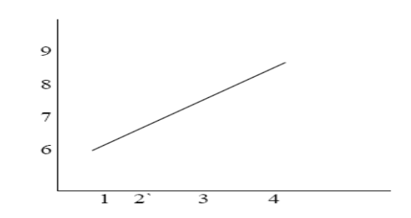
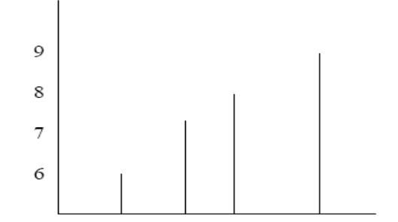
5.plot (t, x)
Explanation : Ifx = [6 7 8 9] t = [1 2 3 4] This instruction will display a figure window which indicates the plot of x versus t.
Output:
6.stem (t,x)
Output:

Slide 8
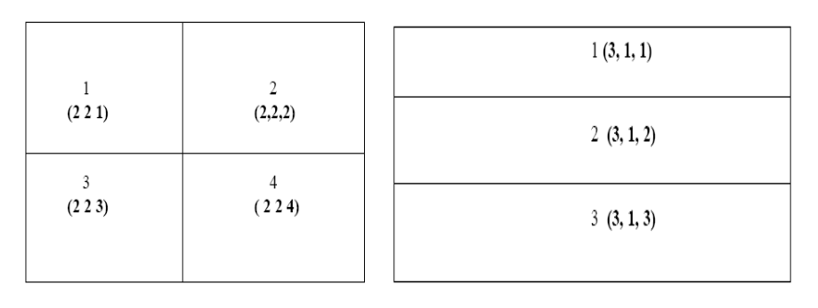
7.Subplot
Explanation : This function divides the figure window into rows and columns. Subplot (2 2 1) divides the figure window into 2 rows and 2 columns 1 represent number of the figure
Subplot (3 1 2) divides the figure window into 3 rows and 1 column 2 represent number of the figure .

Slide 9
8.xlabel Syntax: xlabel('string') Description: xlabel('string') labels the x-axis of the current axes.
9. ylabel Syntax : ylabel('string') Description: ylabel('string') labels the y-axis of the current axes
10.Title Syntax : title('string') Description: title('string') outputs the string at the top and in the center of the current axes.
11.grid on Syntax : grid on Description: grid on adds major grid lines to the current axes.
Notes:
سؤال :
C = A.*B multiplies arrays A and B element by element and returns the result in C.
A = [1 0 3]; B = [2 3 7]; C = A.*B
C=2 0 21
C=A*B >>> errore why?

Slide 10
Generation of basic signals:
1. Unit impulse signal. 2. Unit step signal. 3. Unit ramp signal. 4. Exponential growing signal. 5. Exponential decaying signal. 6. Sine signal. 7. Cosine signal.
8. Random Signals.

Slide 11
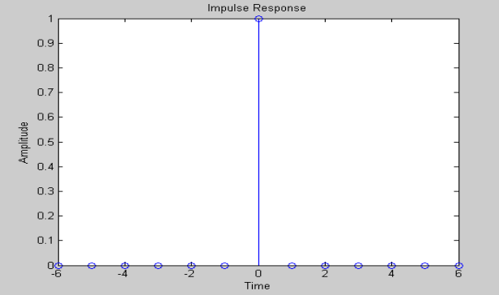
1. Unit impulse signal.
clc; clear all; close all; dis p('UNIT I MPUL SE SIGNAL '); N=input(' E nter Number of Samples: '); n=-N:1:N x=[zeros(1,N) 1 ze ros(1,N)] stem(n,x); xlabel('Time'); ylabel('Amplitude'); title('Impulse Response');

Slide 12
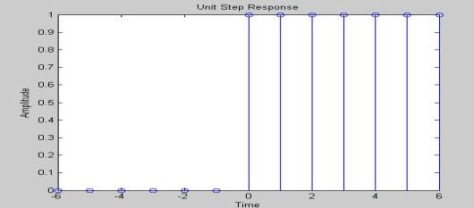
2. Unit step signal.
clc; clear all; close all; dis p('UNIT STE P SIGN AL'); N=input(' Enter Number of Samples : '); n=-N:1:N x=[zeros(1,N) 1 ones (1,N)] stem(n,x); xlabel('Time'); ylabel('Amplitude'); title('Unit Ste p Response');

Slide 13
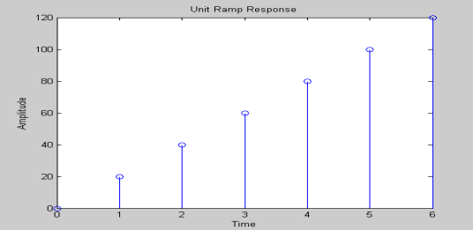
3. Unit ramp signal.
clc; clear all; close all; dis p('UNIT RA MP SIGN AL'); N=input(' Enter Number of Samples : '); a=input('Enter Amplitude : ') n=0:1:N x=a *n stem(n,x); xlabel('Time'); ylabel('Amplitude'); title('Unit Ramp Response');

Slide 14
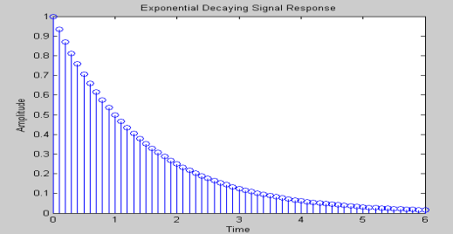
4. Exponential decaying signal.
clc; clear all; close all; dis p('E XPONE NT IAL DE C AYING SIGNAL '); N=input(' Enter Number of Samples : '); a=0.5 n=0:.1:N x=a.^ n stem(n,x); xlabel('Time'); ylabel('Amplitude'); title('Exponential Decaying Signal Response');

Slide 15
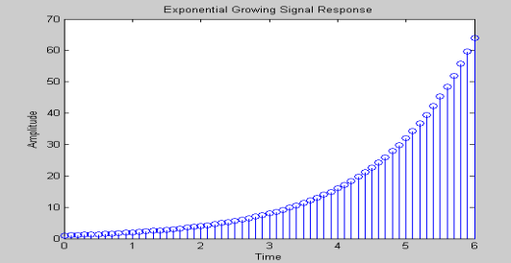
5. Exponential growing signal.
clc; clear all; close all; dis p('E XPONE NT IAL GR O WING SIGNAL '); N=input(' Enter Number of Samples : '); a=0.5 n=0:.1:N x=a.^ -n stem(n,x); xlabel('Time'); ylabel('Amplitude'); title('Exponential Growing Signal Response');

Slide 16
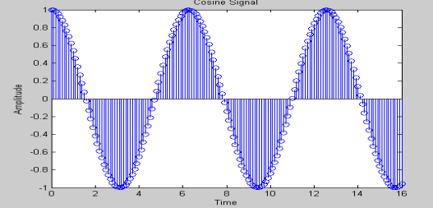
6. Cosine signal.
clc; clear all; close all; dis p('COSINE SIGNAL '); N=input(' Enter Number of Samples : '); n=0:.1:N x=cos(n) stem(n,x); xlabel('Time'); ylabel('Amplitude'); title('Cosine Signal');

Slide 17
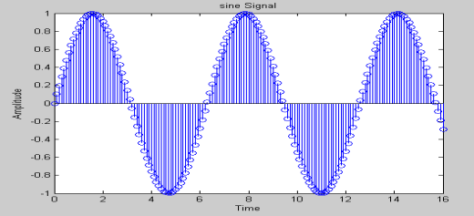
7. Sine signal. clc; clear all; close all; dis p('SINE SIGNAL '); N=input(' Enter Number of Samples : '); n=0:.1:N x=sin(n) stem(n,x); xlabel('Time'); ylabel('Amplitude'); title('sine Signa l');

Slide 18
8.Random Signals:
A random signal of length N with samples uniformly distributed in the interval (0,1) can be generated by using the MATLAB command
x = rand(1,N);
a random signal x[n] of length N with samples normally distributed with zero mean and unity variance can be generated by using the following MATLAB command
x = randn(1,N);

Slide 19
Home WORK:
Write a MATLAB program to generate and display a random signal of length 100 whose elements are uniformly distributed in the interval [−2, 2].
Write a MATLAB program to generate and display a Gaussian random signal of length 75 whose elements are normally distributed with zero mean and a variance of 3.
HINT:
standard deviation = sqrt(variance); x = standard deviation *randn(1,N)+ mean;

Slide 20
Implementation :
generate the following sine sígnalas then find the sumation of signals.
y1=sin(t); y2=sin(3*t)/3; y3=sin(5*t)/5; y4=sin(7*t)/7; y5=sin(9*t)/9;

Slide 21
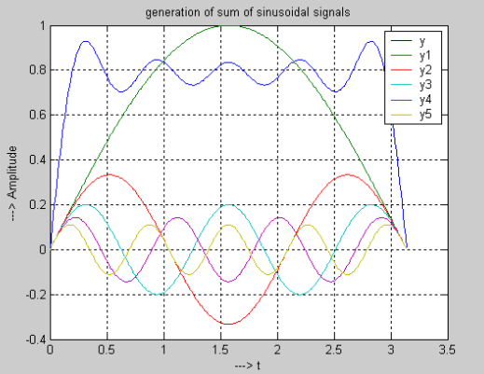
Solution :
clc; clear all; close all; tic; t=0:.01:pi; %generation of sine signals y1=sin(t); y2=sin(3*t)/3; y3=sin(5*t)/5; y4=sin(7*t)/7; y5=sin(9*t)/9; y = sin(t) + sin(3*t)/3 + sin(5*t)/5 + sin(7*t)/7 + sin(9*t)/9; plot(t,y,t,y1,t,y2,t,y3,t,y4,t,y5); legend('y','y1','y2','y3','y4','y5'); title('generation of sum of sinusoidal signals');grid; ylabel('---> Amplitude'); xlabel('---> t'); toc;
NOTE: tic & toc Start a stopwatch timer. The sequence of commands
Notes:
صوت الانسان عبارة عن مجموعة من التون بالتالي صوت الانسان عبارة عن عدد لانهائي من ال sine signals

Slide 22
daliaaug2019@gmail.com

